Slide 1
Basline/Best Guess
Pipeline: Baseline
Vessel Pathway: Base
Port Pathway: Base

Slide 2
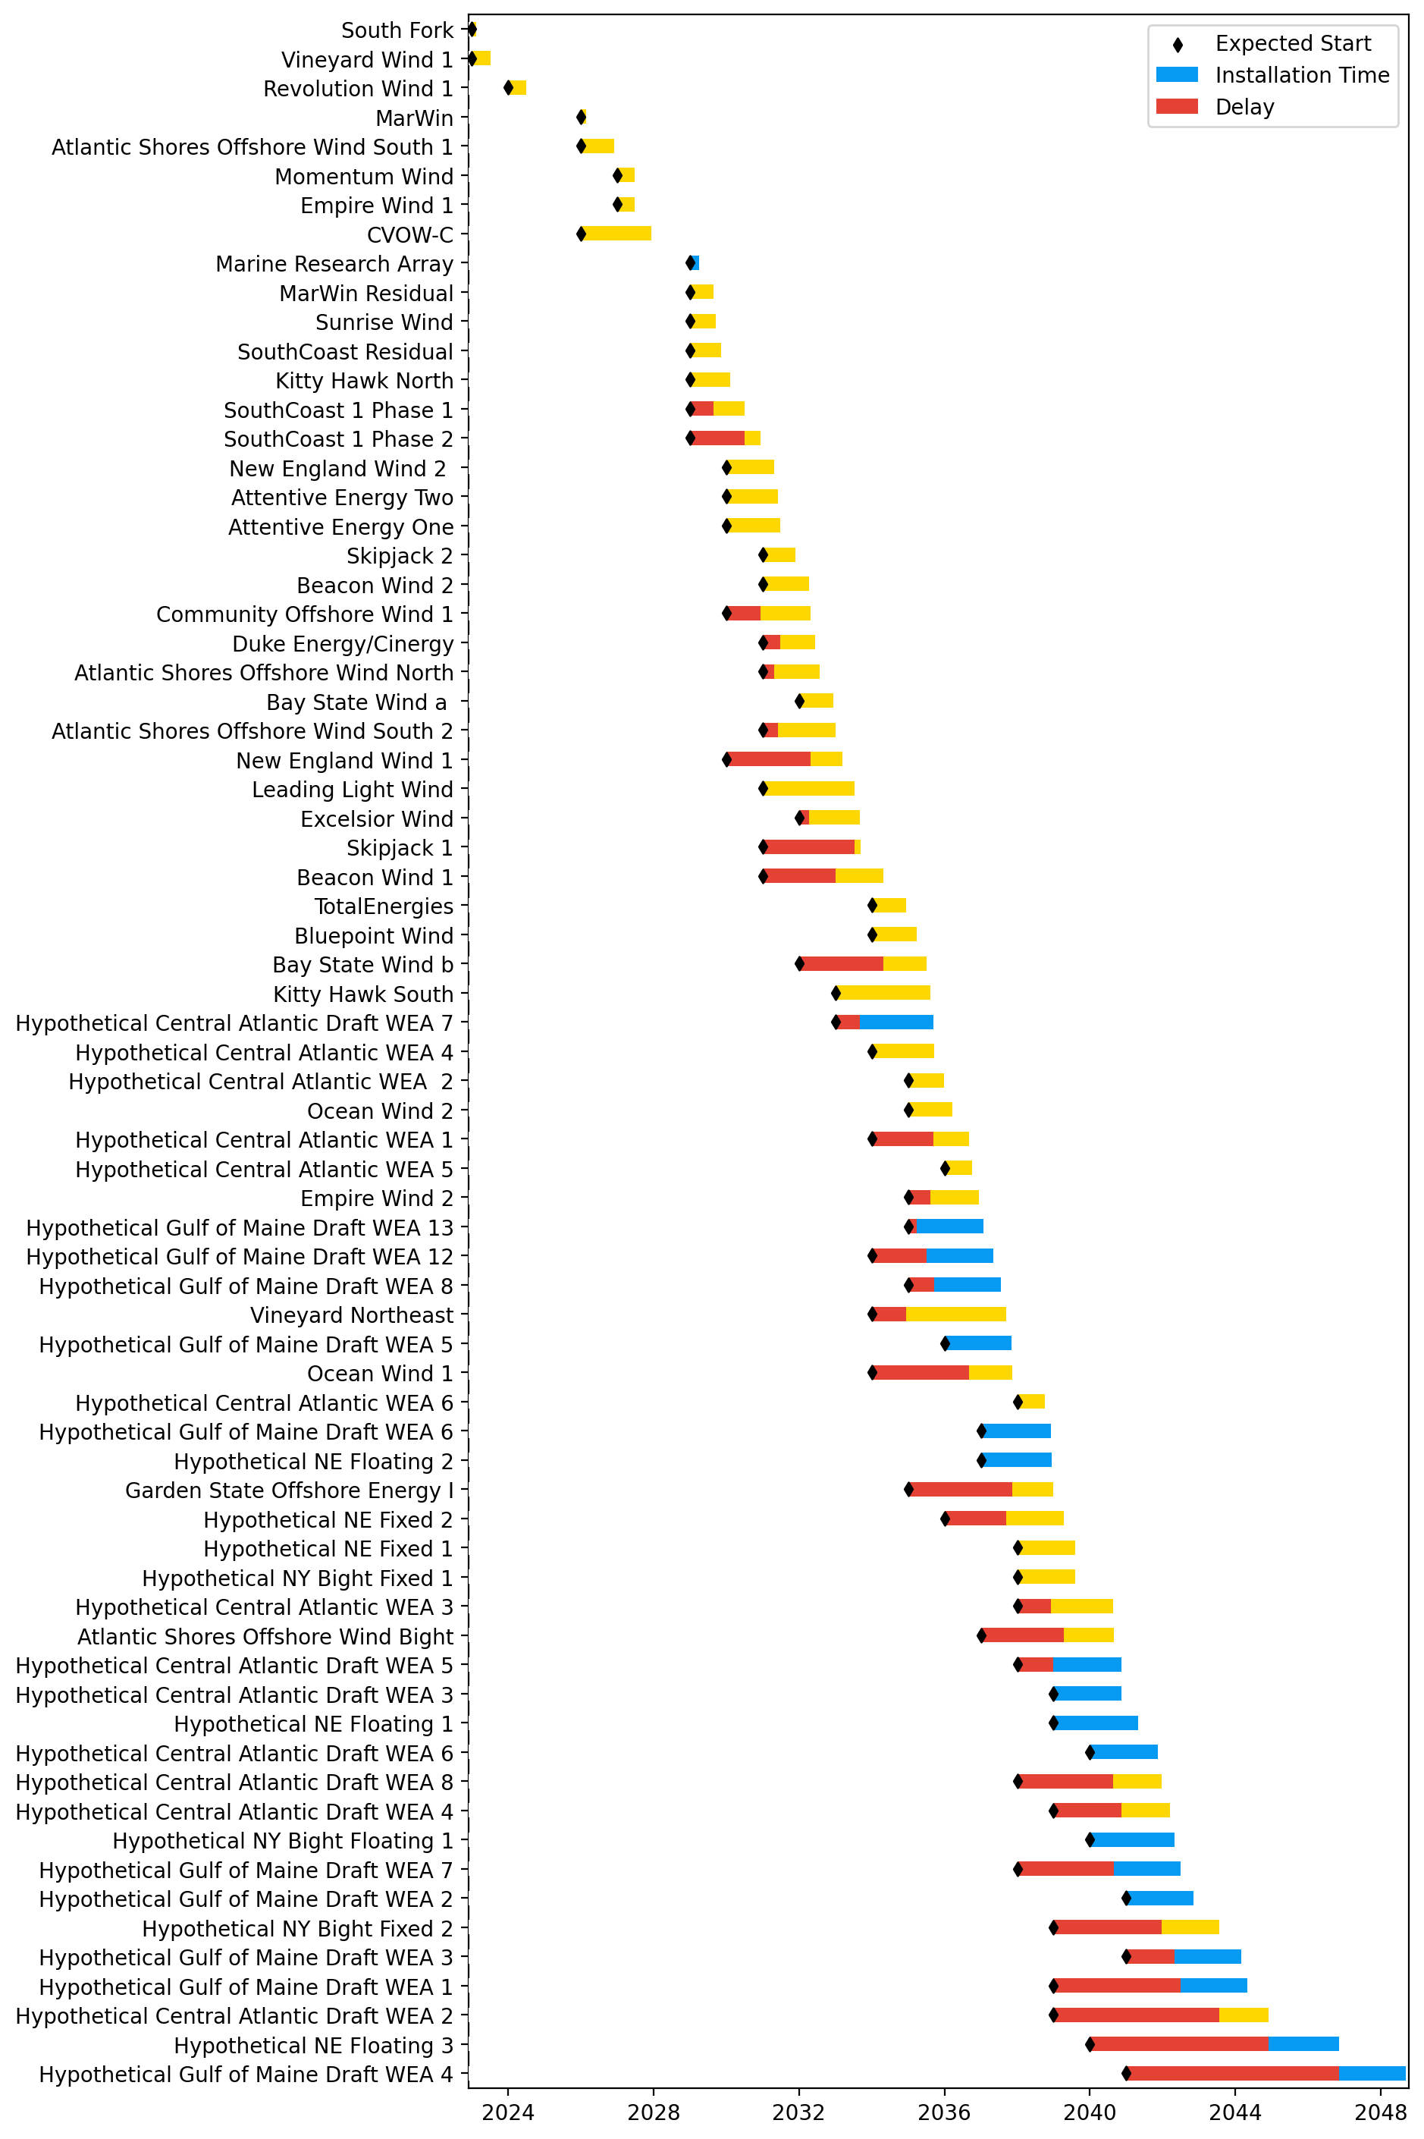
Full Gantt

Slide 3
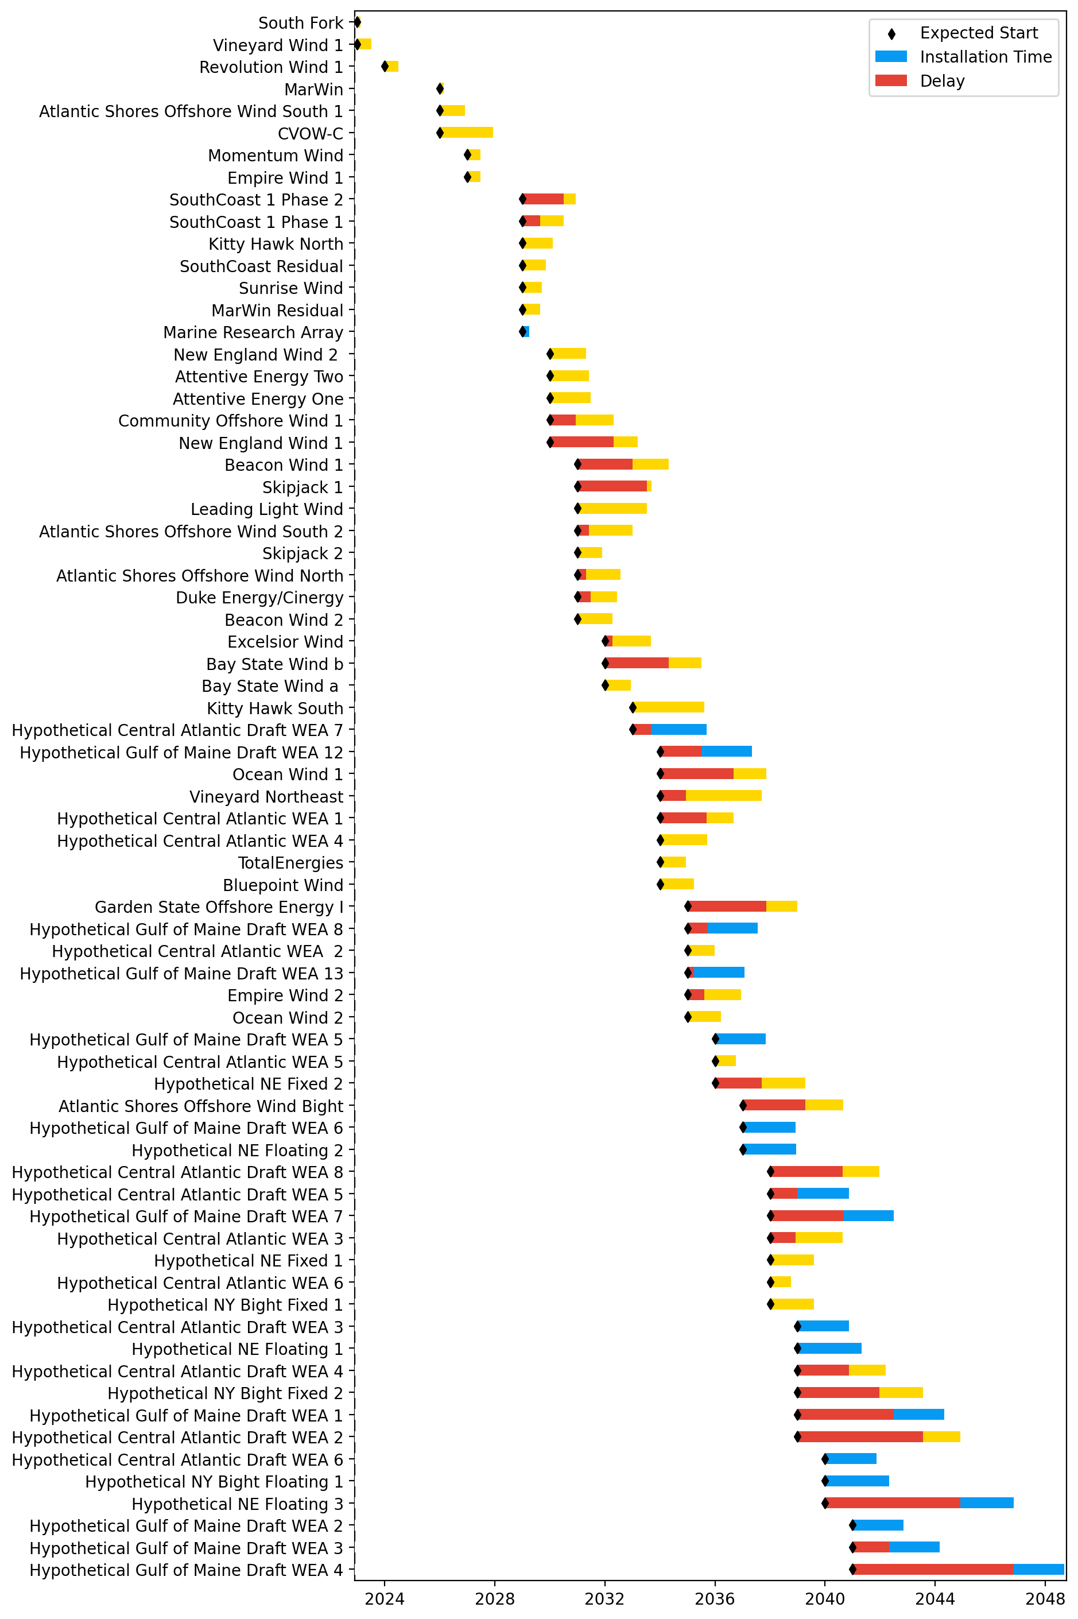
Sorted Full Gantt

Slide 4
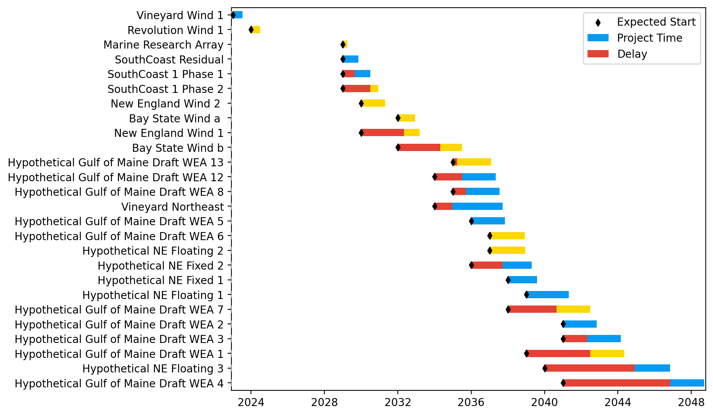
New England Gantt

Slide 5
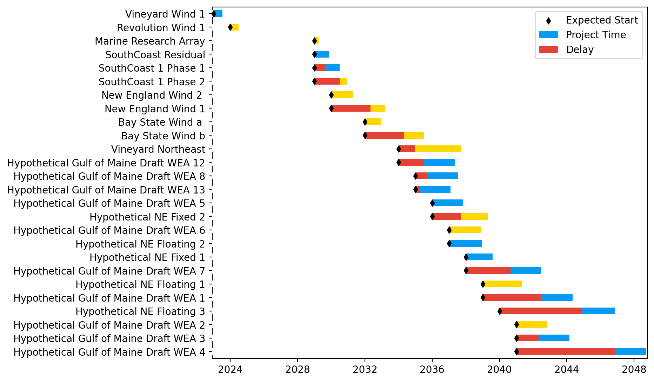
Sorted New England Gantt

Slide 6
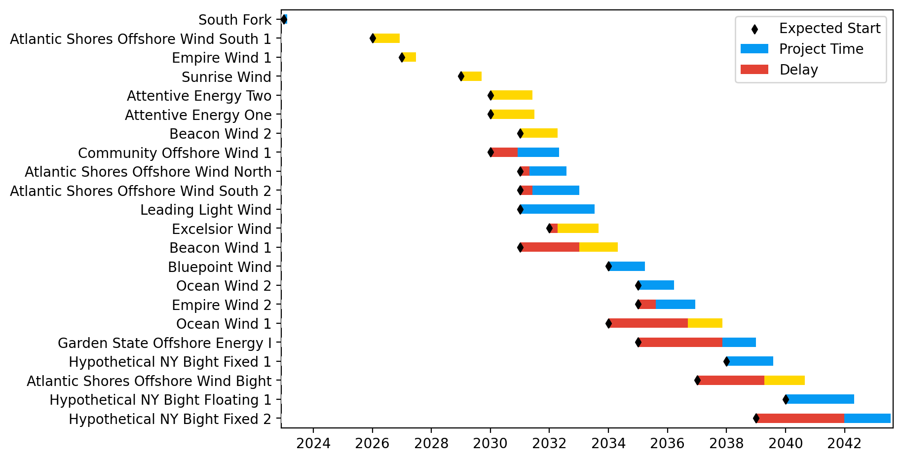
New York/New Jersey Gantt

Slide 7
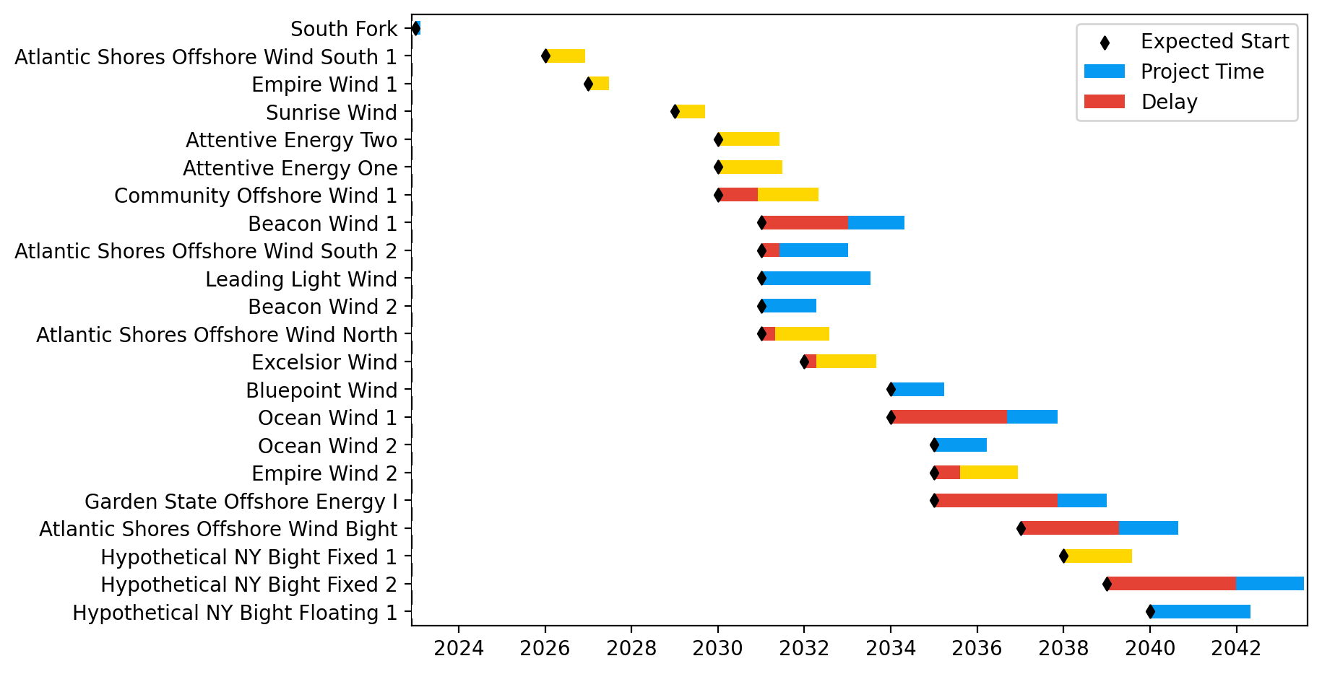
Sorted New York/New Jersey Gantt

Slide 8
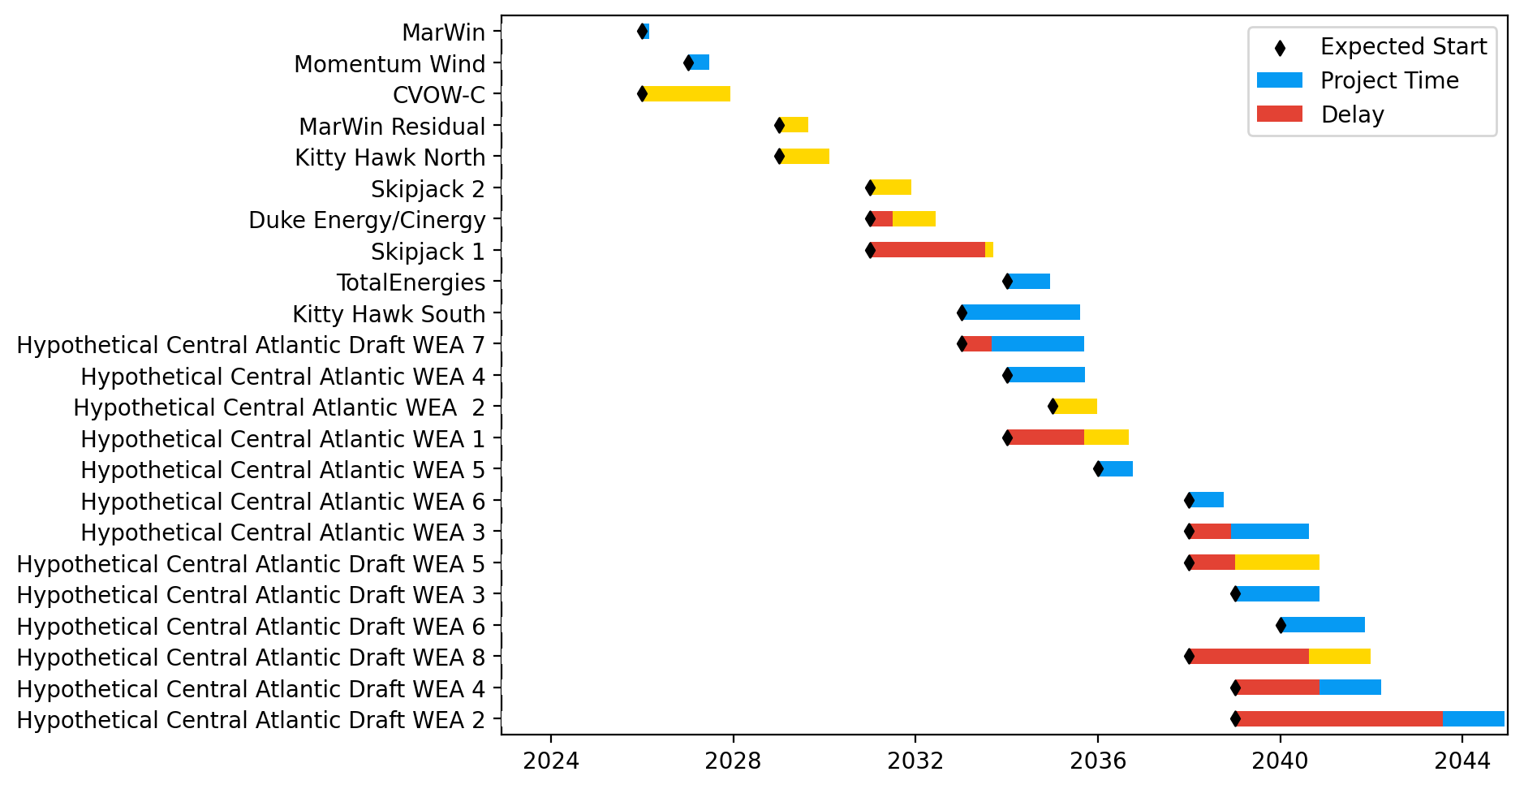
Midatlantic Gantt

Slide 9
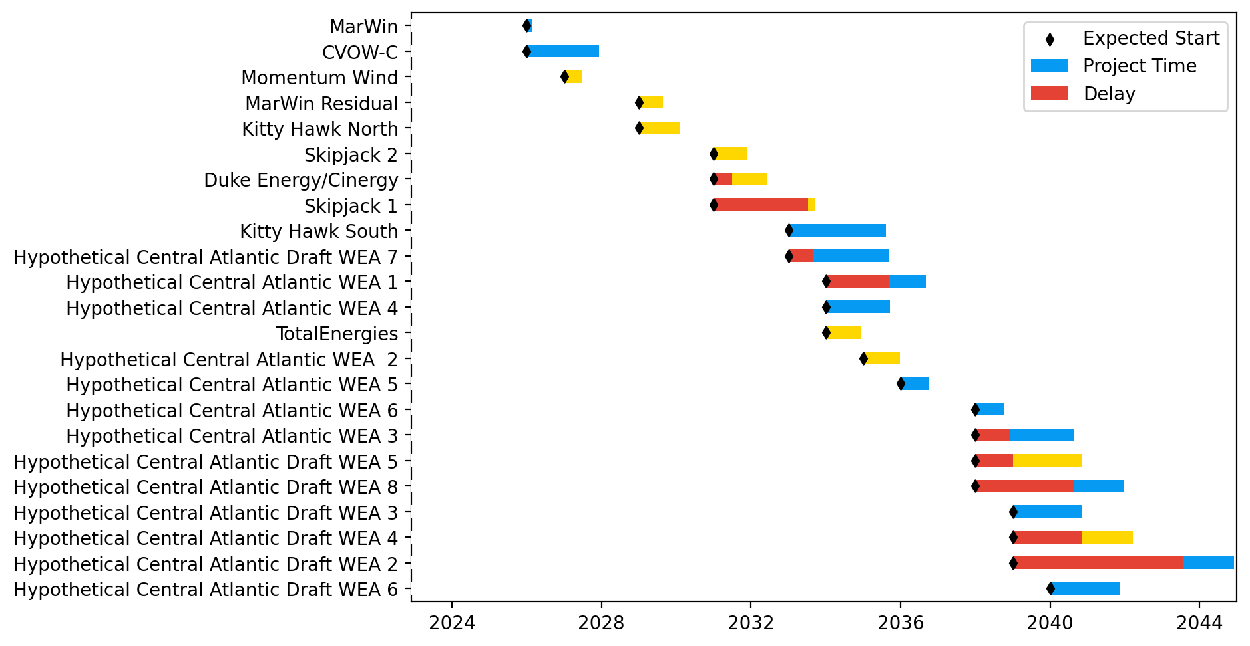
Sorted Midatlantic Gantt

Slide 10
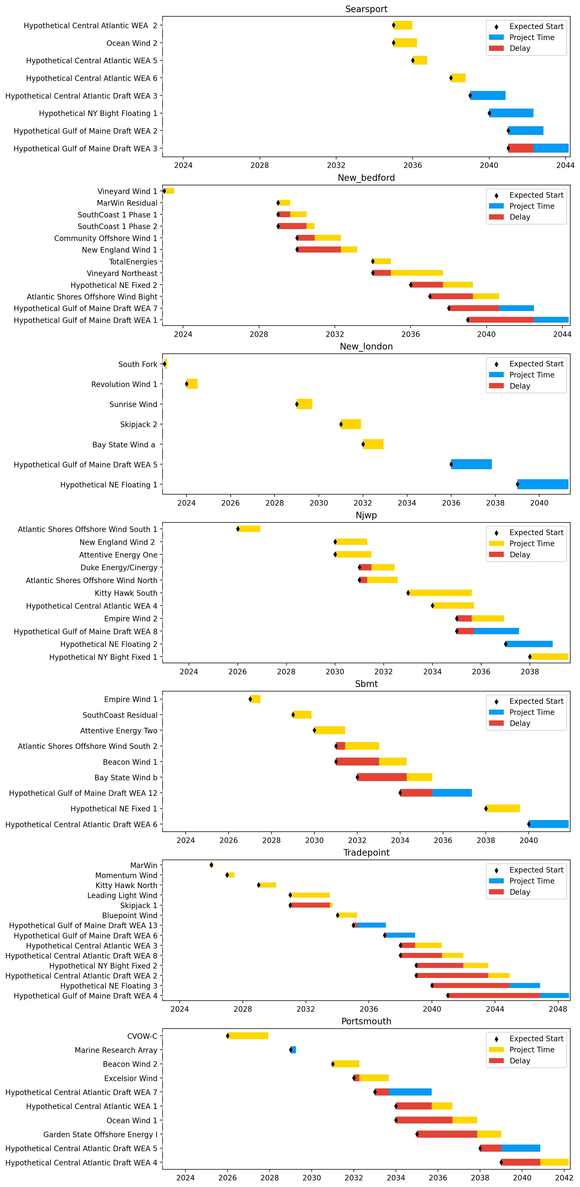
Port Gantts

Slide 11
Sorted Port Gantts

Slide 12
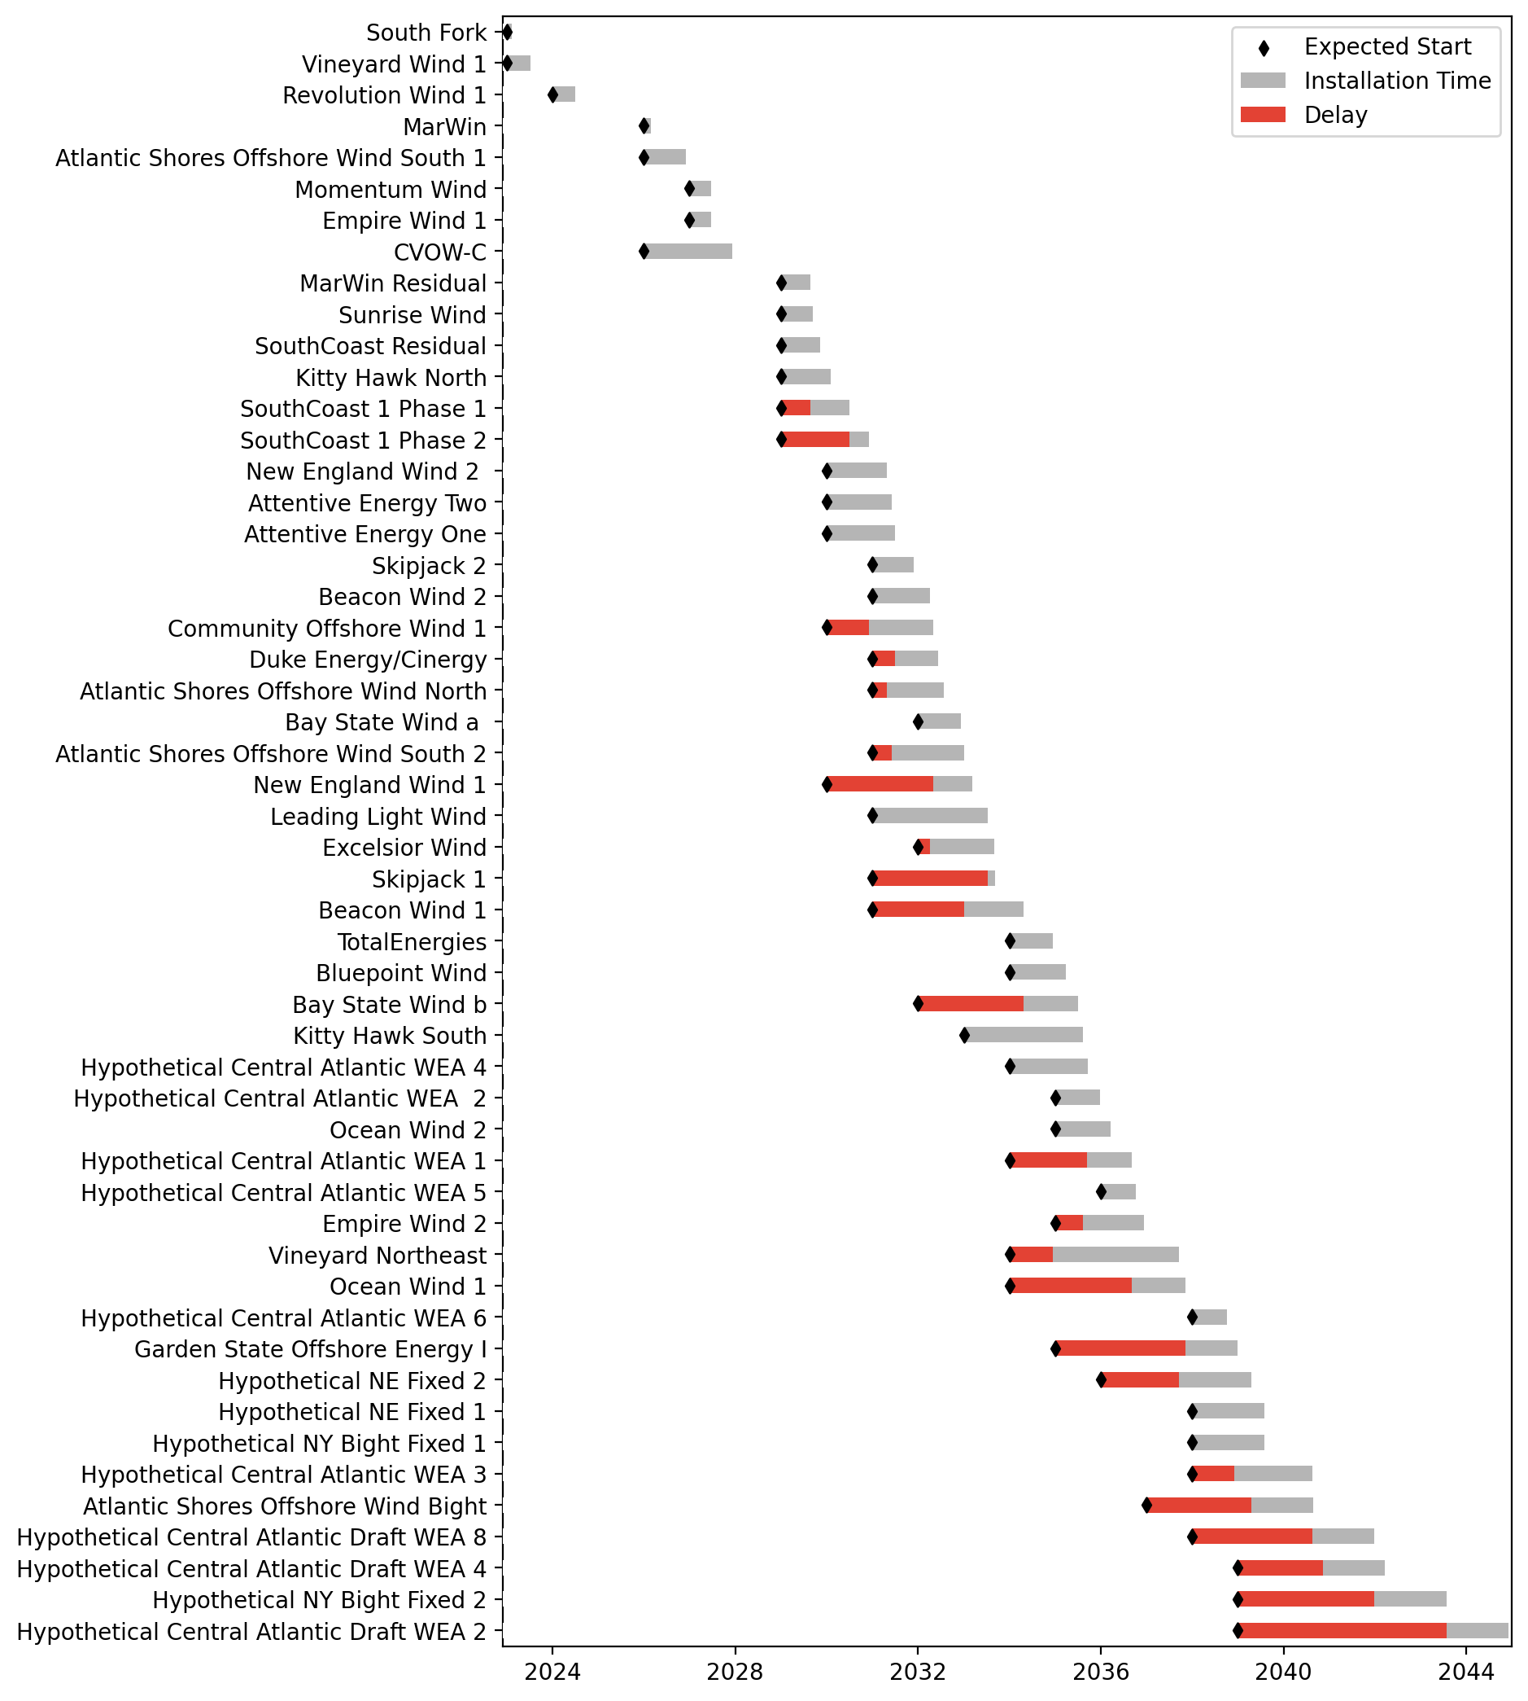
Fixed Gantt

Slide 13
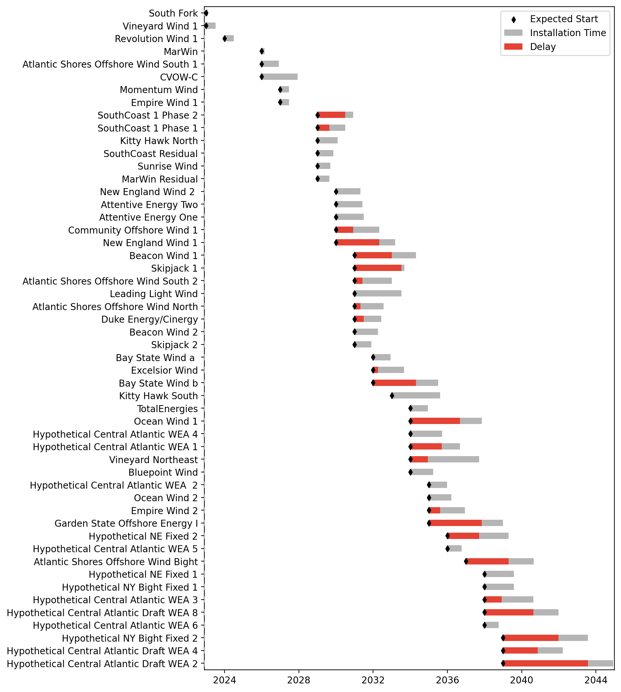
Sorted Fixed Gantt

Slide 14
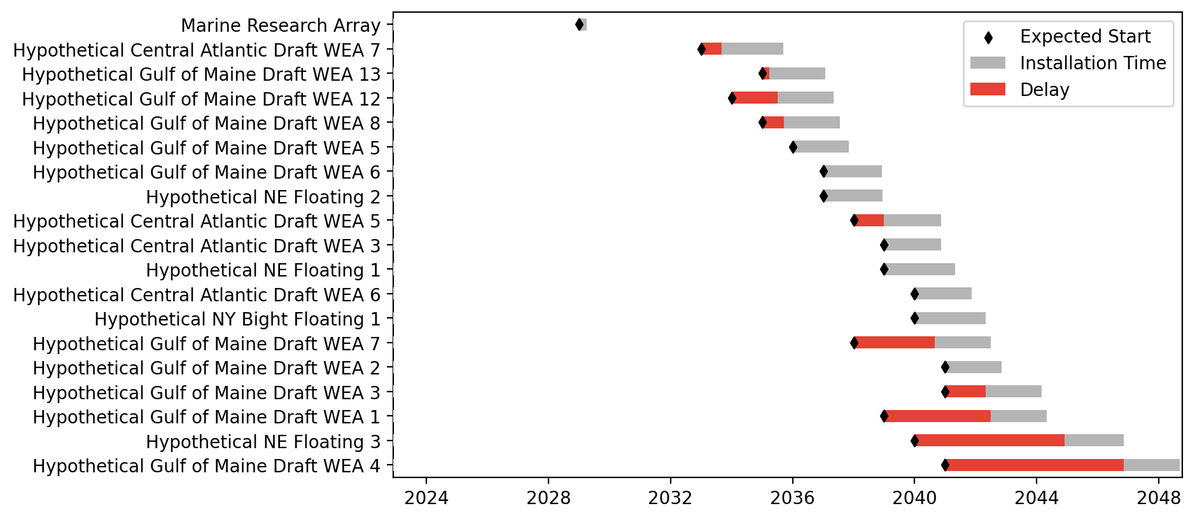
Floating Gantt

Slide 15
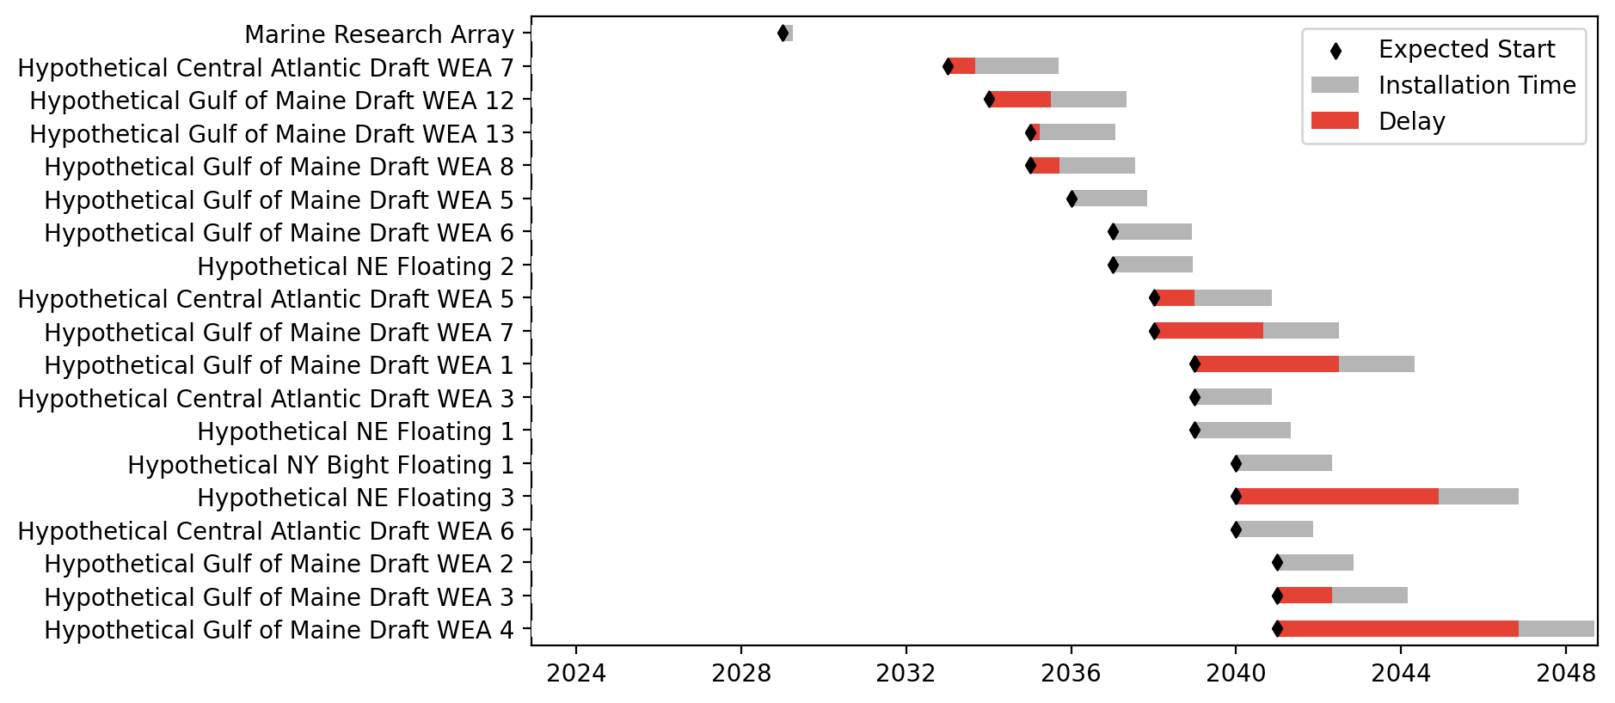
Sorted Floating Gantt

Slide 16
Basline/Unconstrained Vessels
Pipeline: Baseline
Vessel Pathway: Unconstrained
Port Pathway: Base

Slide 17
Full Gantt

Slide 18
Sorted Full Gantt

Slide 19
New England Gantt

Slide 20
Sorted New England Gantt

Slide 21
New York/New Jersey Gantt

Slide 22
Sorted New York/New Jersey Gantt

Slide 23
Midatlantic Gantt

Slide 24
Sorted Midatlantic Gantt

Slide 25
Port Gantts

Slide 26
Sorted Port Gantts

Slide 27
Fixed Gantt

Slide 28
Sorted Fixed Gantt

Slide 29
Floating Gantt

Slide 30
Sorted Floating Gantt

Slide 31
Basline/Unconstrained Vessels
Pipeline: Baseline
Vessel Pathway: Base
Port Pathway: Unconstrained

Slide 32
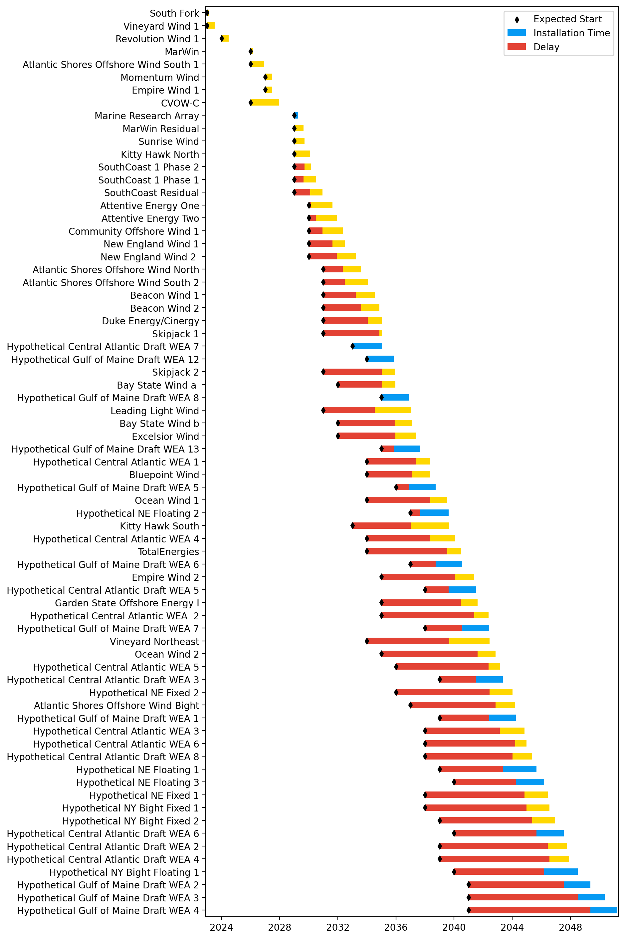
Full Gantt

Slide 33
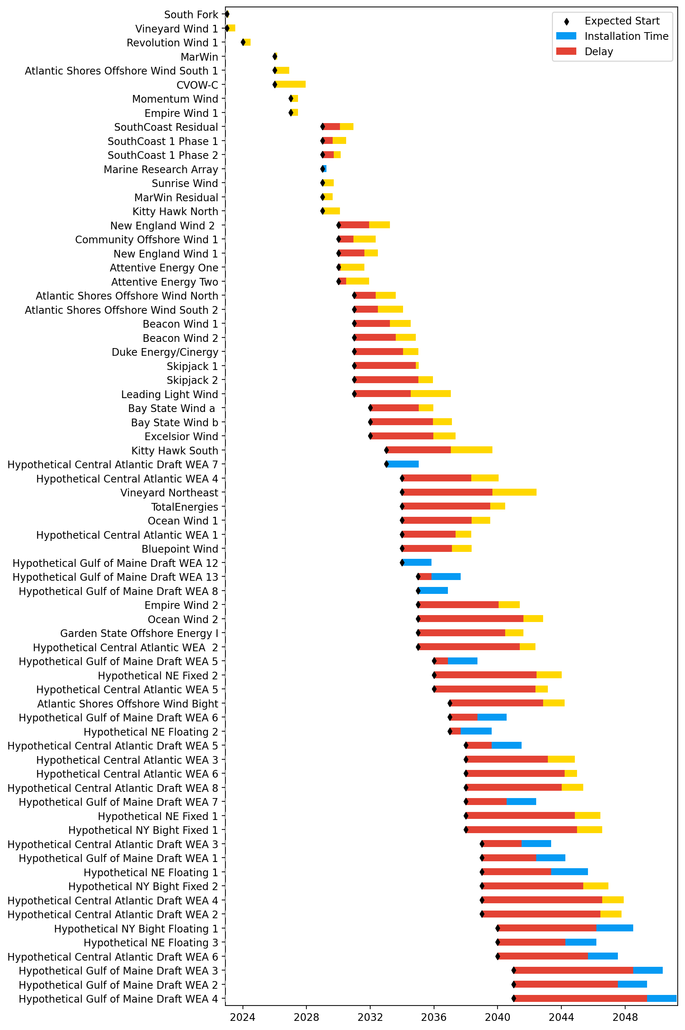
Sorted Full Gantt

Slide 34
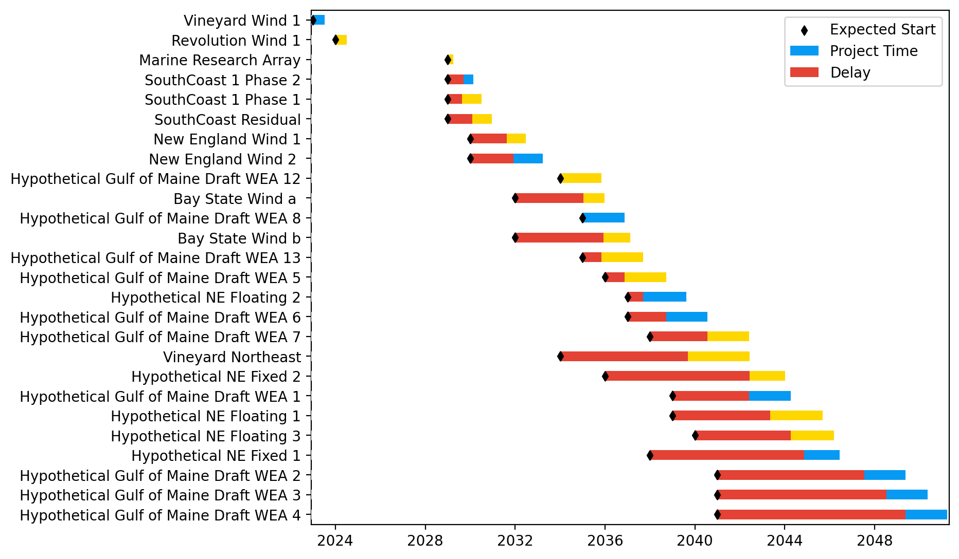
New England Gantt

Slide 35
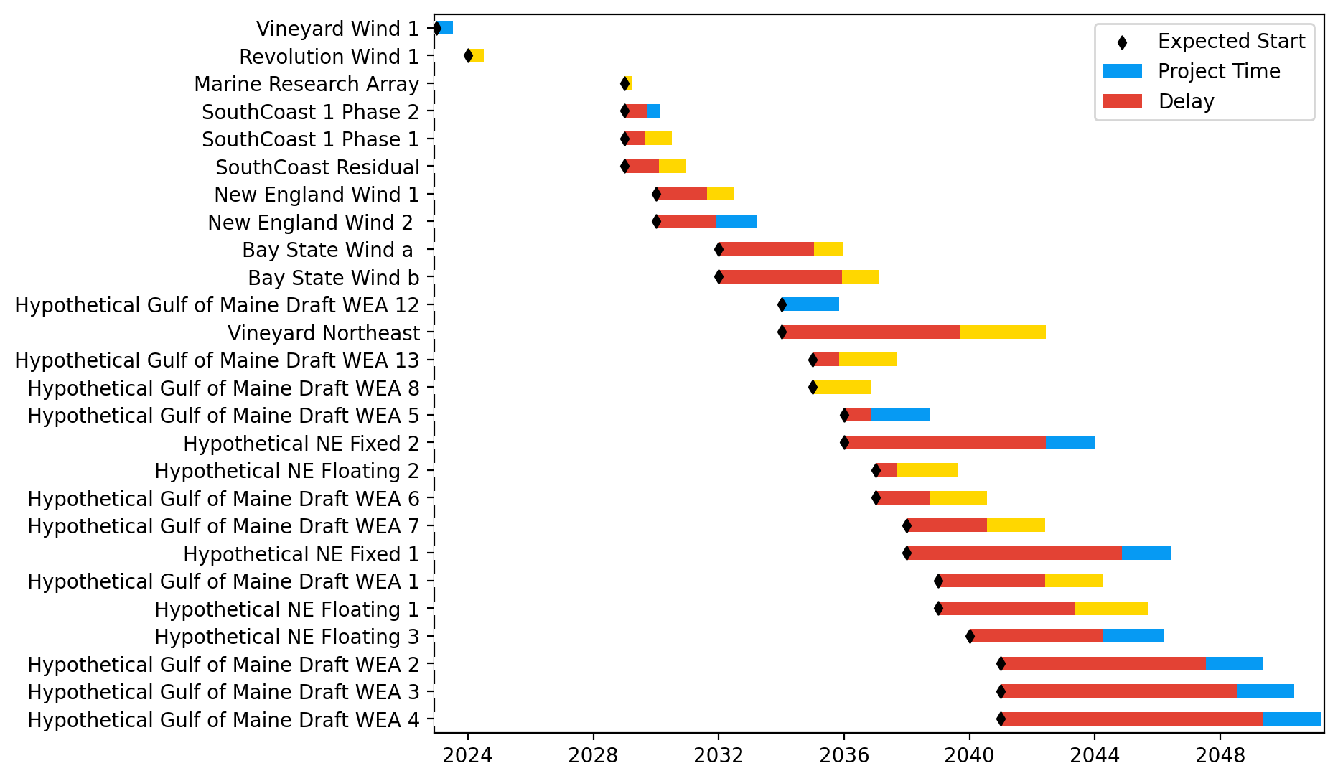
Sorted New England Gantt

Slide 36
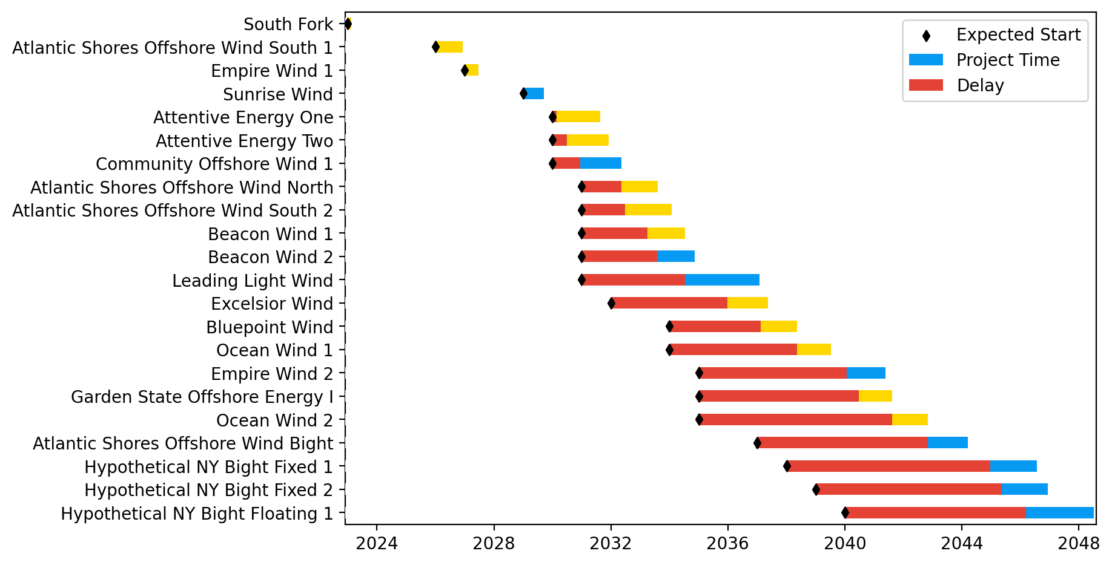
New York/New Jersey Gantt

Slide 37
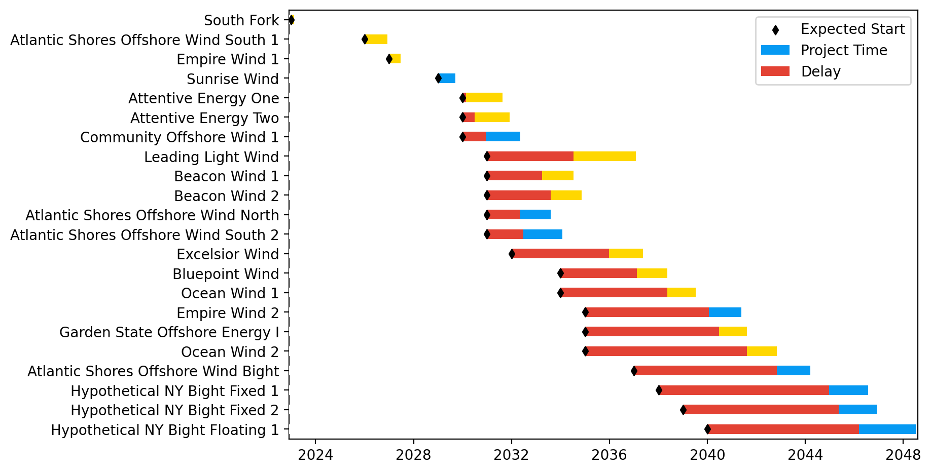
Sorted New York/New Jersey Gantt

Slide 38
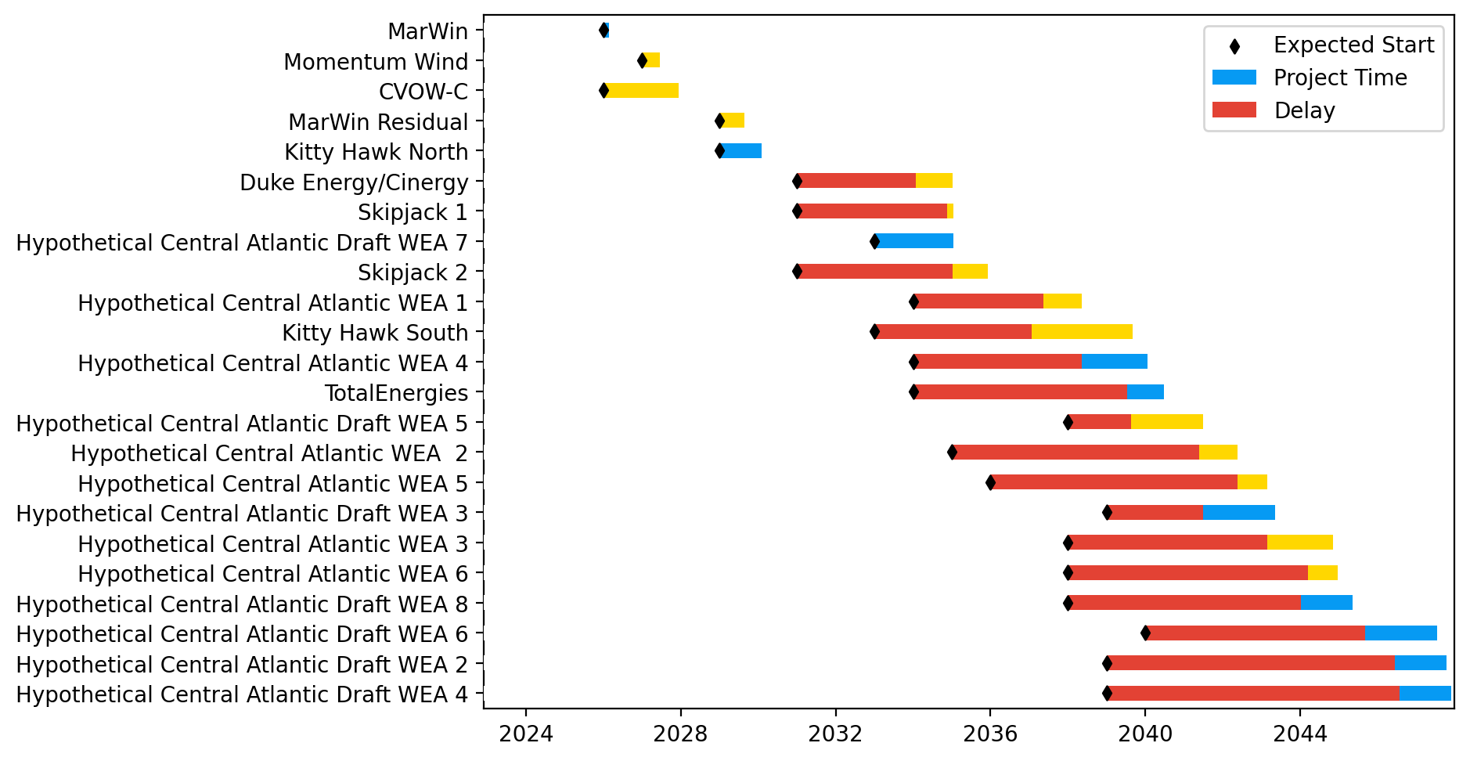
Midatlantic Gantt

Slide 39
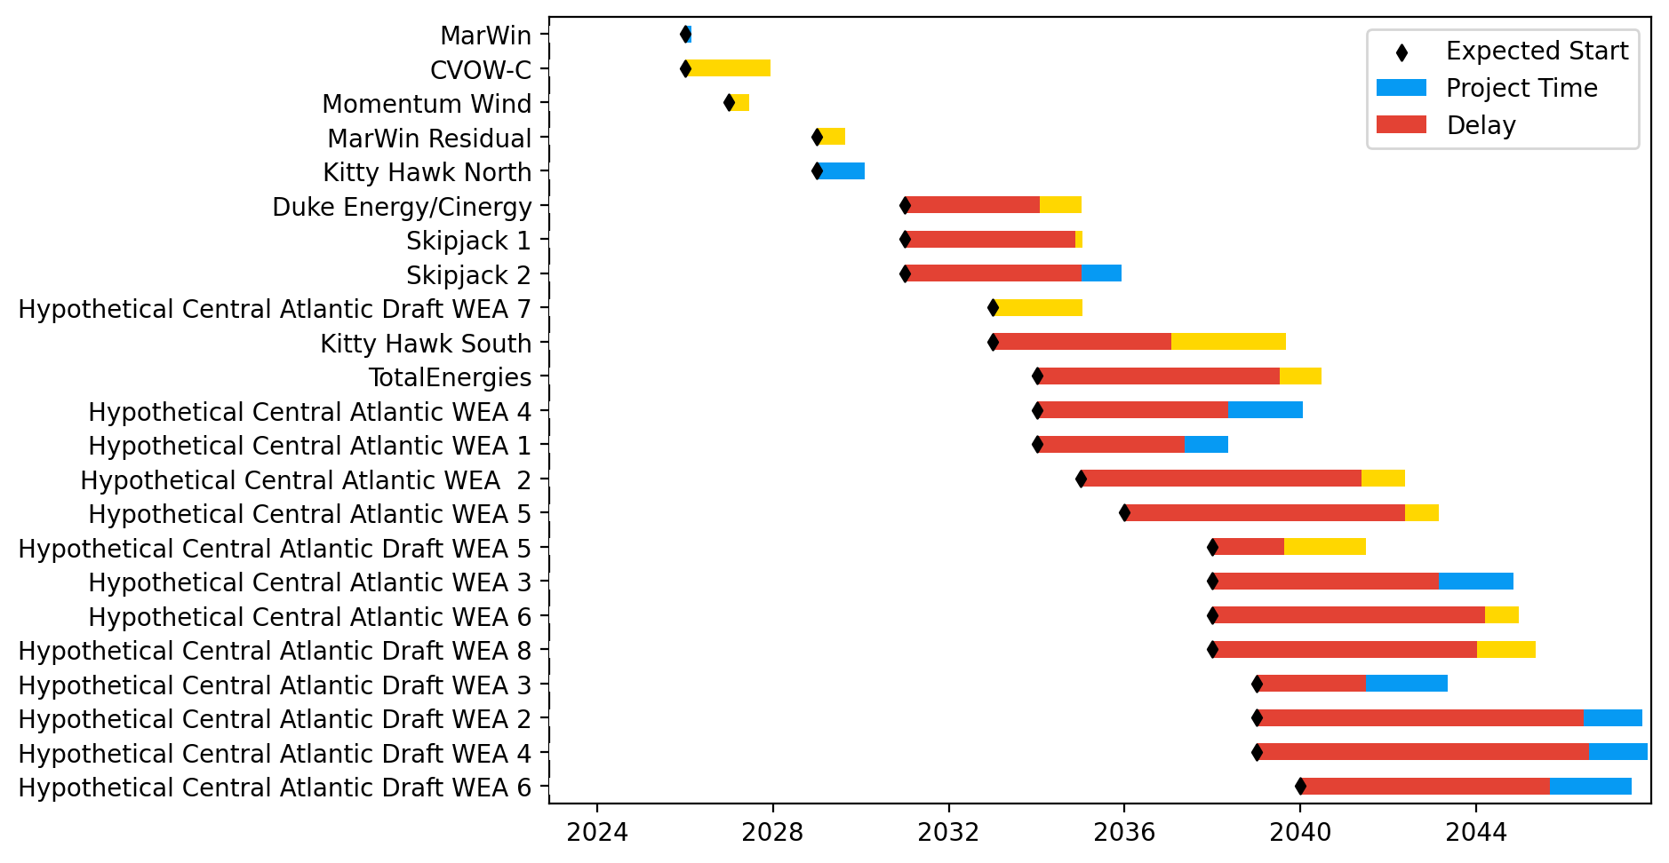
Sorted Midatlantic Gantt

Slide 40
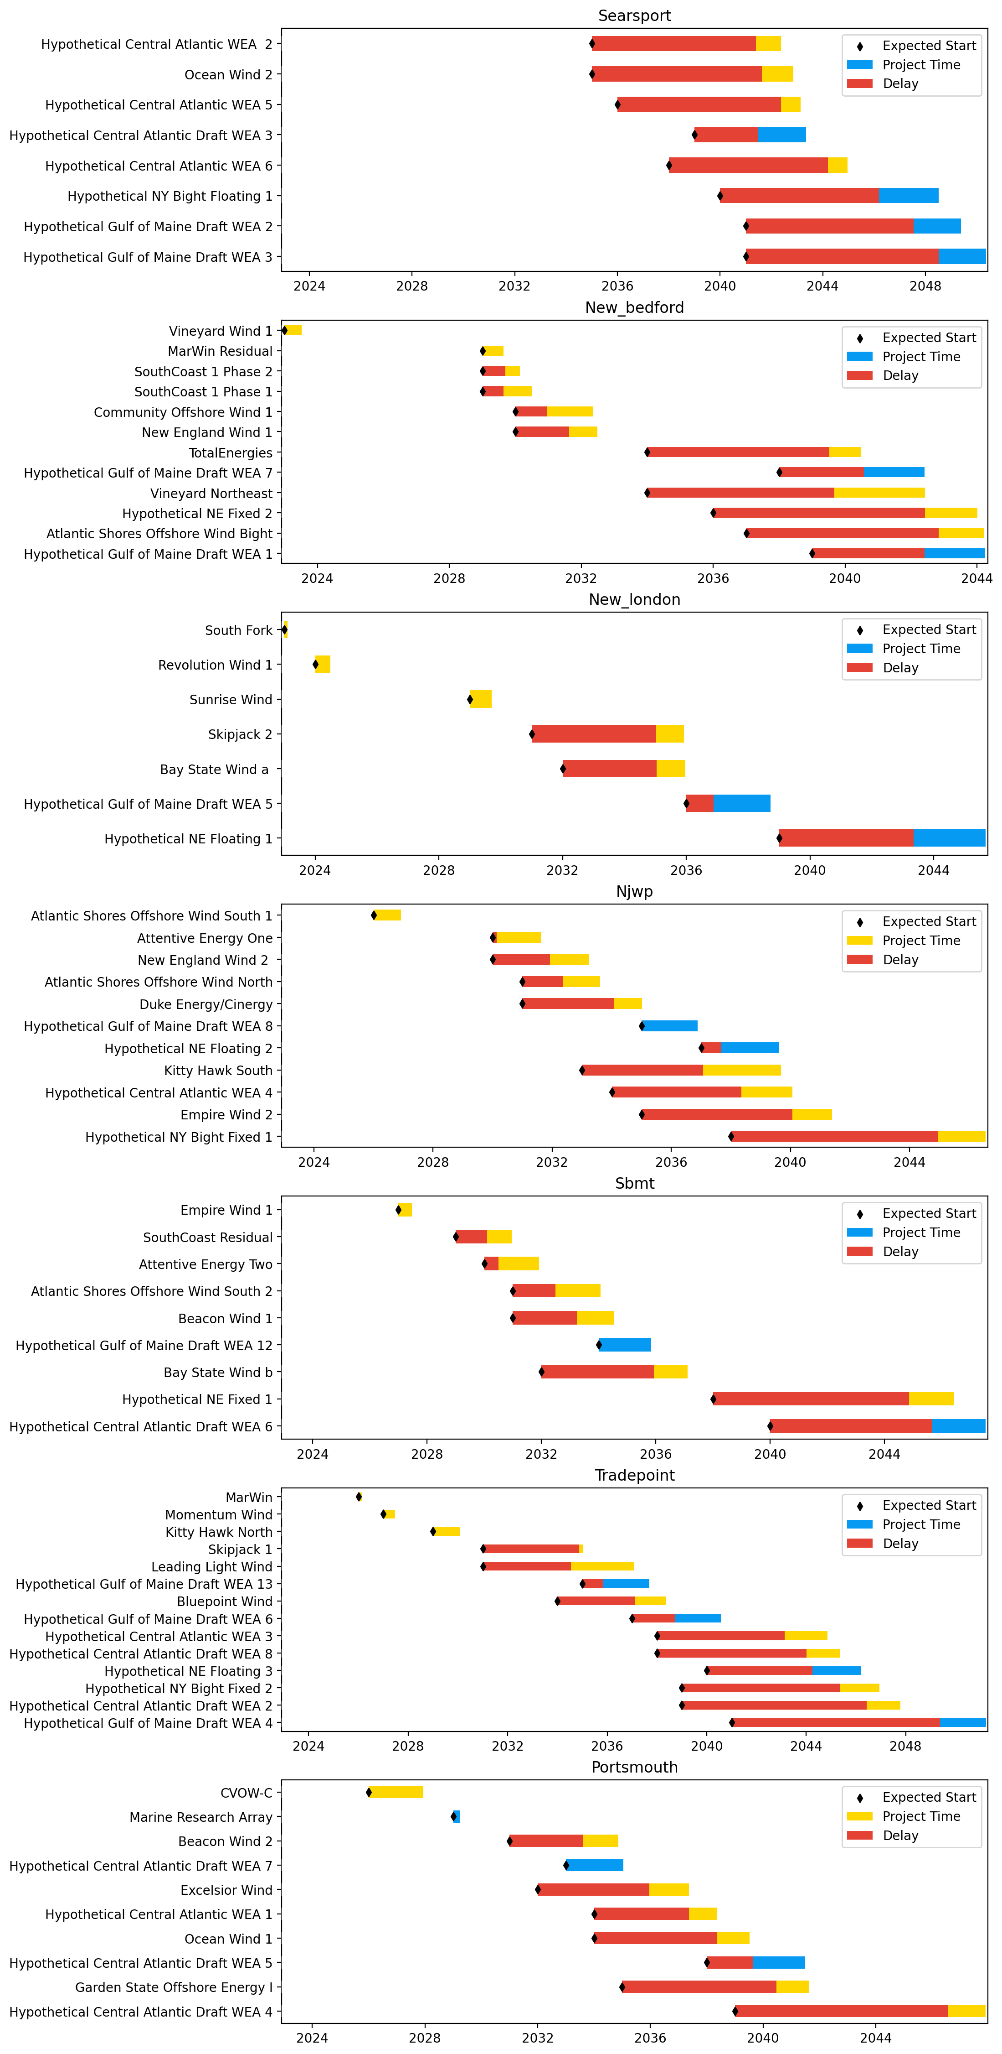
Port Gantts

Slide 41
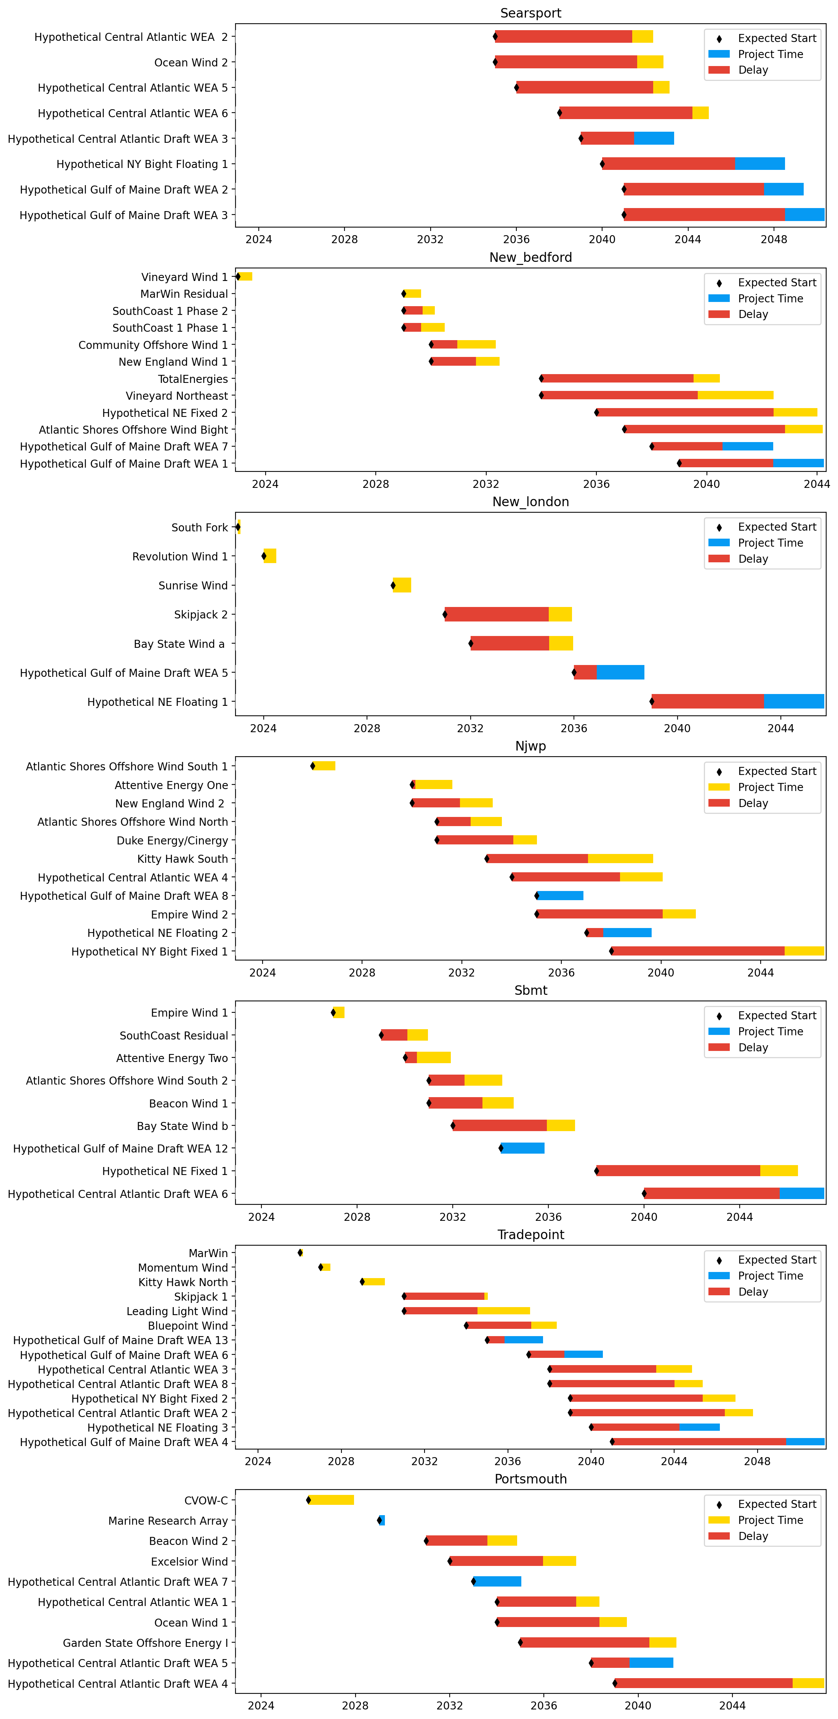
Sorted Port Gantts

Slide 42
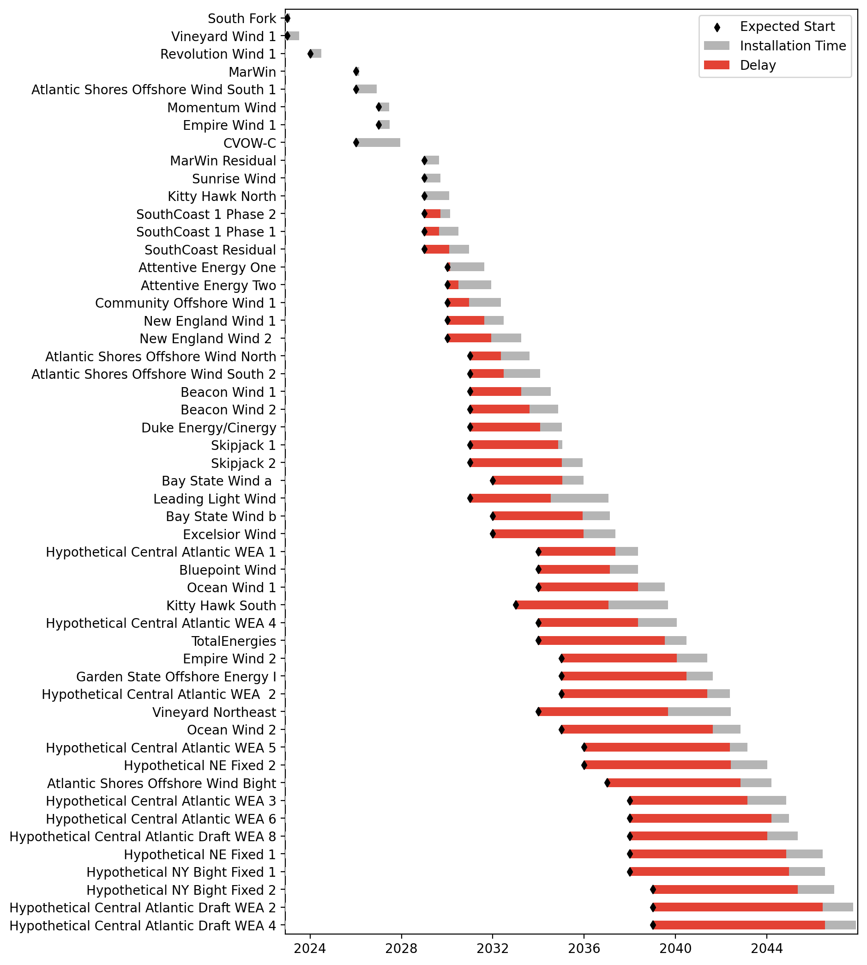
Fixed Gantt

Slide 43
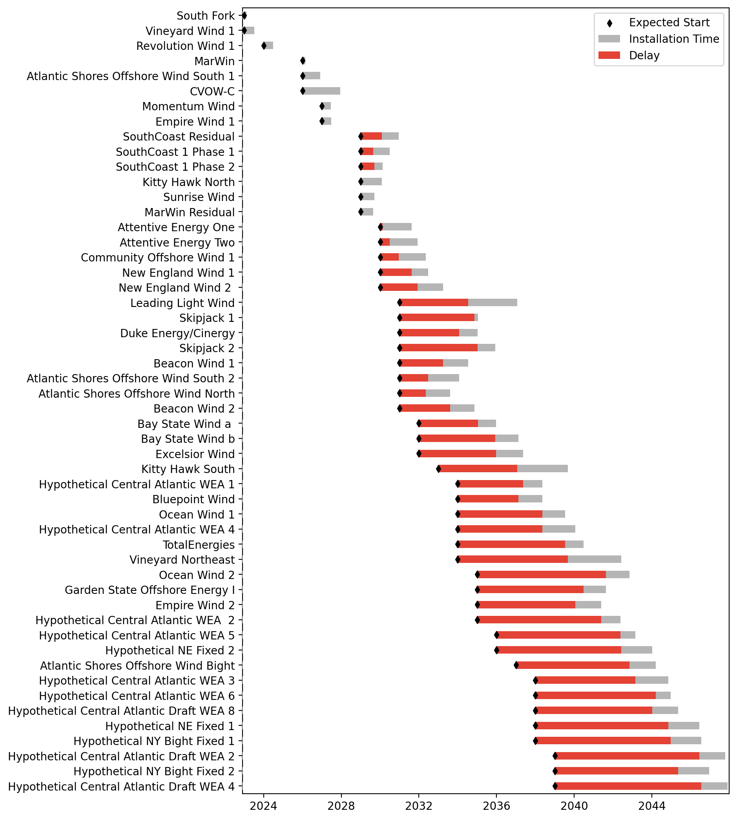
Sorted Fixed Gantt

Slide 44
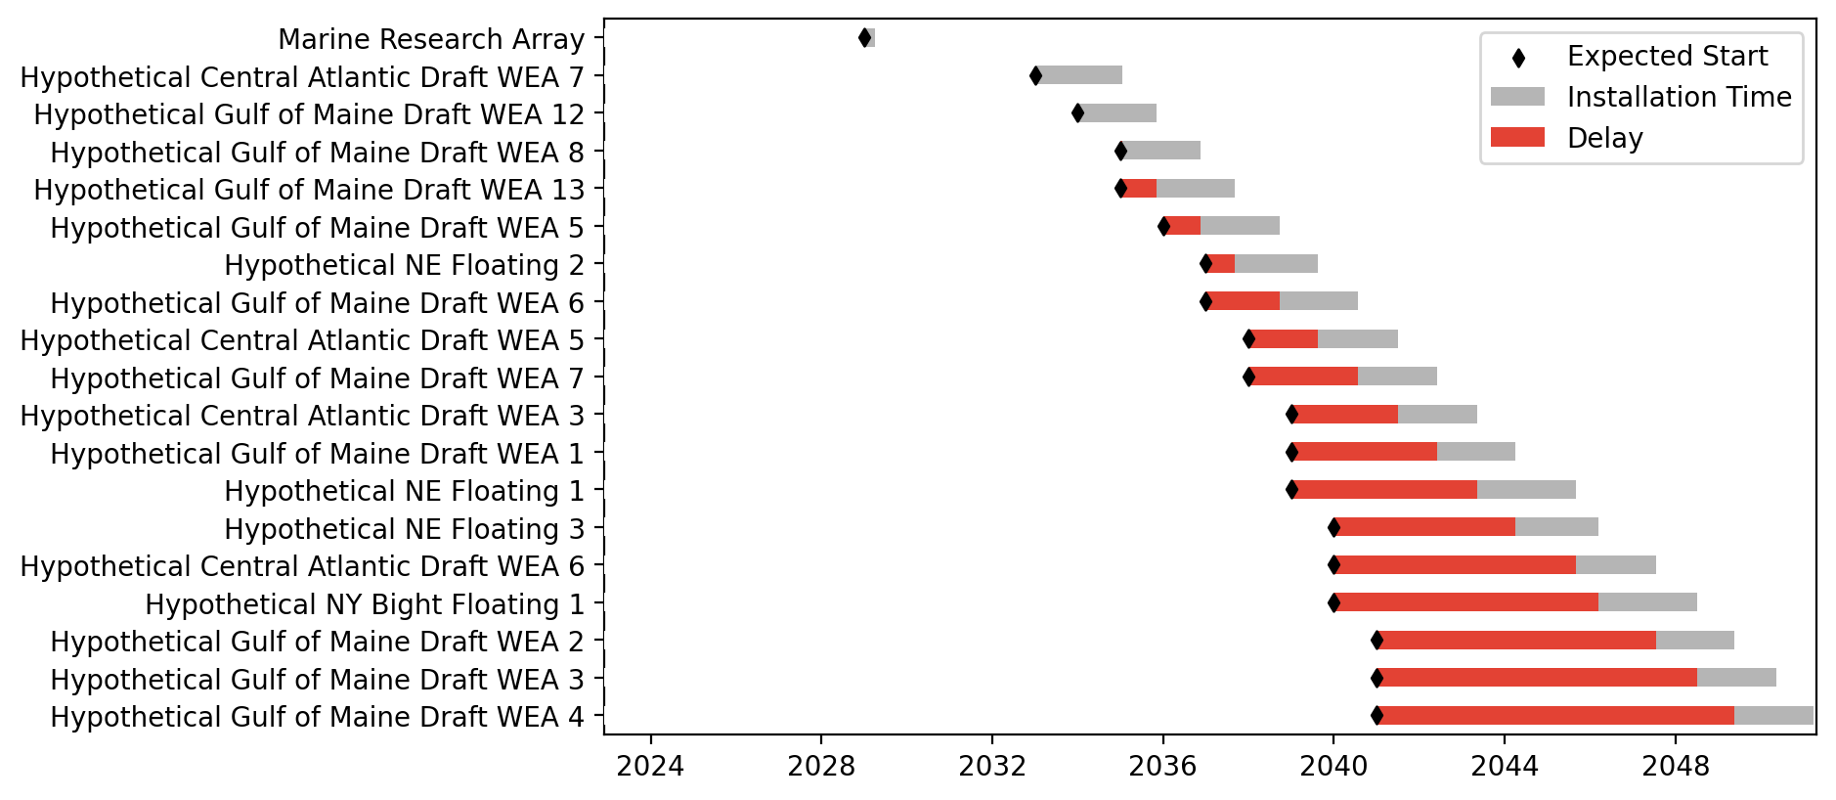
Floating Gantt

Slide 45

Sorted Floating Gantt

Slide 46
Comparison Plots
Base Pathway
Unconstrained Vessels
Unconstraied Ports

Slide 47
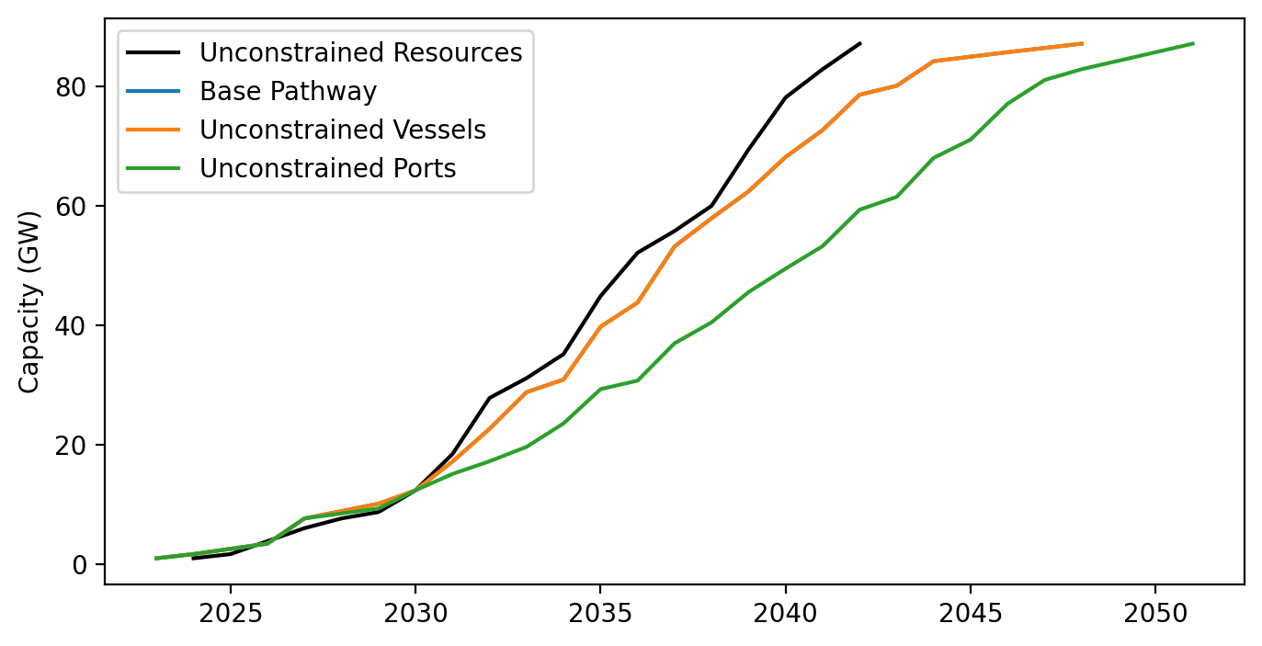
Cummulative Installed Capacity

